Slide 1
Machine Translation for
African Languages
Sheriff Issaka

Slide 2
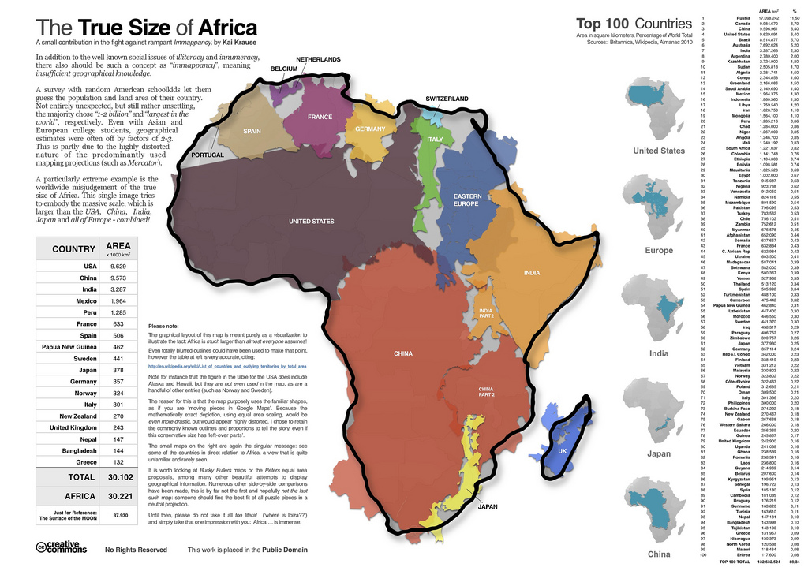
African Languages Landscape
Notes:
Natalia

Slide 3
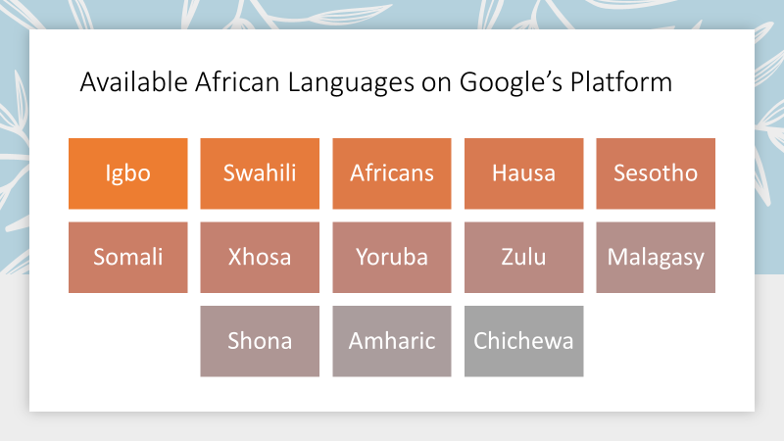
Notes:
Natalia

Slide 4
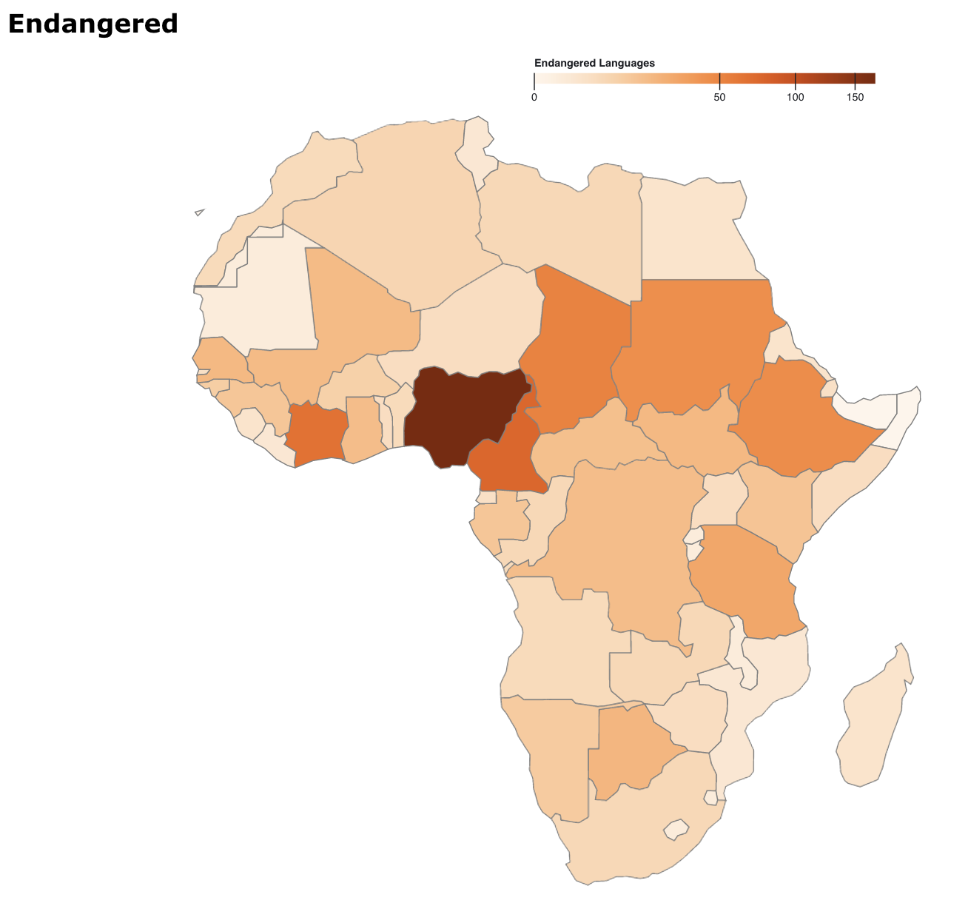
Endangered and Active languages
Demo
Notes:
Natalia

Slide 5
African Languages Lab
Curating, cleaning, digitizing, and translating African languages
Conducting research
Integrating all available resources
Notes:
Sheriff

Slide 6
Starting with ‘TWI’ (17 MILLION SPEAKERS)
Building a MT model
Current BLEU score of 0.467
Using Transformers
Leveraging pre-trained models
BART

Slide 7
Real translation | Our translation | BLEU
Bere a Adam ne Hawa yɛɛ bɔne no, dɛn na efii emu bae? | Bere a Adam ne Hawa yɛɛ bɔne no, dɛn na efii emu bae? | 1.0
N Opoku ani Gye asɛm bi a ɛwɔ nsɛmma nhoma no emu ho nanso na onni sika. | N Opoku ani Gye asɛm bi a ɛwɔ nsɛmma nhoma no emu ho nanso na onni sika. | 1.0
Apuei ne Atɔe hyia wɔ Moscow ne Kiev | Apuei ne Atɔe Famia wɔ Moscow ne Kiev,,,,,,,,,,,,,,,,,,,,,,,,,,,,,,,,,,,,,,,,,,,,,,,,,,,,,,, | 0.5
Ɔkyerɛkyerɛfo pa tie asɛm na ama wanya nhumu | Ɔkyerɛkyerɛfo pa tie asɛm no ama wanya nhumu,,,,,,,,,,,,,,,,,,,,,,,,,,,,,,,,,,,,,,,,,,,,,,,,,,, | 0.5
Wɔafi Ase Redi Euro No! | Euroɔde Eurose Bi Europ!!,,,,,,,,,,,,,,,,,,,,,,,,,,,,,,,,,,,,,,,,,,,,,,,,,, | 0.0
Wɔhyɛ Daakye a Ɛyɛ Soronko ho bɔ | Daɔhyɛ �akye Sor Ɛsonɛ Soronko ho Bɔ,,,,,,,,,,,,,,,,,,,,,,,,,,,,,, | 0.0

Slide 8
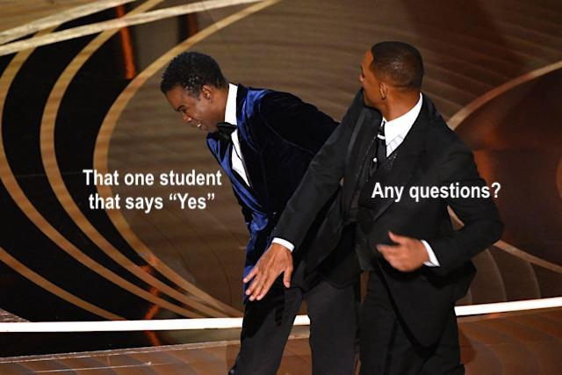
Notes:
Find memes

